Slide 1
AIChE Track Talk
Wednesday, May 20, 2016
Speakers: Slava Butkovich, Kayane Dingilian, Shi En Kim, Alp Mehmet Sunol

Slide 2
General ChE Required Courses
Ch/ChE9
Ch41abc
ChE 62, ChE63ab
ACM95ab
Ph 2/12a
Ch21abc
ChE101, ChE105
ChE103abc
ChE126
Ch/ChE91
One of Ec11, BEM102 or BEM103
& a track!

Slide 3
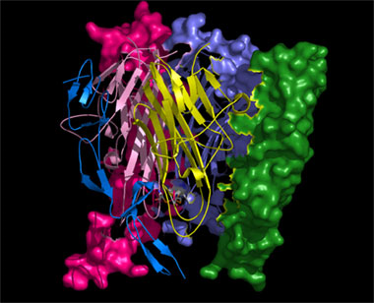
Biomolecular Track
What it includes
Biological design and engineering
Biomaterials
What you learn
Biomolecular / cell design and engineering
Molecular biology
Computational modeling
Any other areas of interest

Slide 4
Biomolecular Track: Courses
Bi/Ch 110 (1st) (junior)
BE/ChE 163 (1st or 3rd depending on 169) (junior or senior)
ChE 130 (junior or senior) or ChE90AB (senior)
Five Bioengineering / Related Electives:
Any other BE class (biomechanics, biomaterials, bio labs, evolution, biological flows, MRI)
What I’ve done: physiology, microfluidics, computer science/bioengineering crossover classes
ChE 118 or ChE 120 count

Slide 5
Sample schedule
Sophomore Year
Ch 41a | 9 | Ch 41b | 9 | Ch 41c | 9
ChE 62 | 9 | ChE 63a | 9 | ChE 63b | 9
ACM95a | 12 | ACM95b | 12 | ACM95c | 12
Ma 2a / Ph 2a | 18 | Ma 2b / Ph 2b | 18 | Ch/ChE 9 | 9
 |  |  |  | PS 12 | 9
 |  |  |  | PE 27c | 3
Totals | 48 |  | 48 |  | 50
Junior Year
ChE 103a | 9 | ChE 103b | 9 | ChE 103c | 9
Ch 21a | 9 | Ch 24 | 9 | ChE 105 | 9
Bi/Ch 110 | 12 | ChE 101 | 9 | BE 153 | 9
Art 169 | 9 | PS/SS 139 | 9 | Pl/Law 93 | 9
CS 1 | 9 | Pl/HPS 183 | 9 | BEM 107 | 9
Totals | 48 |  | 45 |  | 45
Senior Year
ChE 126 | 9 | BE 141 | 9 | BE 159 | 9
ChE 163 | 9 | BE 150 | 9 | Law 134 | 9
L/F 109 | 9 | BE 157 | 9 | PS 120 | 9
Ch/CHE 91 | 3 | ChE 90a | 9 | ChE 90b | 9
Totals | 30 |  | 36 |  | 36
Different for you guys (2 terms ACM 95)
Also, ChE 15 should be in here (winter term) instead of Ma 2b
- If you’re really going to take CS 1 outside of freshman year, take it before ChE 15

Slide 6
Sophomore Year
Ch 41A (orgo) | 9 |  | Ch 41B | 9 | Ch 41C |  | 9
ChE 62 (separations) | 9 |  | ChE 63A (thermo) | 9 | ChE 63B |  | 9
ACM 95A | 12 |  | ACM 95B | 12 | ACM 95C |  | 12
Ma 2 | 9 |  | ChE 15 (Matlab) | 9 | Ch/ChE 9 |  | 9
Ph 2a | 9 |  | Ec 11 | 9 | En 85 (poetry) |  | 9
 |  |  | PE 48 (Tai Chi) | 3
Totals | 48 |  |  | 51 |  |  | 48
Junior Year
ChE 103A (transport) | 9 |  | ChE 103B | 9 | ChE 103C | 9
BE 98 (self-research) | 9 |  | ChE/BE/MedE 112 (microfluidics) | 9 | ChE 105 (control) | 9
Bi/Ch 110 | 12 |  | En/H 197 | 9 | BE 153 (modeling medicine) | 9
Ch/ChE 91 (writing) | 3 |  | BE/CS/CNS/Bi 191A | 9 | BE/CS/CNS/Bi 191B | 9
Ec 122 (econometrics) | 9 |  | H 108A | 9 | H 108B | 9
L 106A (Japanese) | 9 |  | ChE 80 (self-research) | 3 | ChE 80 | 3
Totals | 51 |  |  | 48 |  | 48
Senior Year
Ch 21A | 9 | Ch 21B |  | 9 | Ch 21C |  | 9
ChE 126 | 9 | ChE 101 |  | 9 | (A bunch of H classes?) |  | 36
ChE 90A | 9 | ChE 90B |  | 9
ChE/BE 163 | 12 | (Advanced Ec or PS) |  | 9
(PS 12 or similar) | 9 | (Some final BE elective) |  | 9
Totals | 48 |  |  | 45 |  |  | 45

Slide 7
Biomolecular Track: Advice
Plan your schedule in advance (if you want . . .)
Remember lab classes take a lot of time (there aren’t that many unless you want to take more)
Some classes are offered alternate years (a.k.a., consider taking “optional” classes like your track-specific classes early)
If applying to graduate school, visitation weekends are at the end of 2nd term
Figure out which classes will count for the track; some Bi/Ch classes may not count
Talk to your advisor or Prof. Flagan
Use the “degree audit” on REGIS to see what requirements you have left
When applying for internships/jobs which are biology- related, emphasize the “biomolecular” part so recruiters know you aren’t a paint-factory/process-y ChemE

Slide 8
Future Opportunities
Graduate school
Chemical Engineering, emphasis on biology
Bioengineering, Biomedical Engineering
Quantitative/Computational Biology
Jobs
Biotechnology (Amgen, Genentech, etc.)
Pharmaceuticals (Pfizer, Roche, etc.)
Medical Research Institutes (City of Hope, etc.)
Food / Consumer Products
And if you’re ambitious… Med School

Slide 9
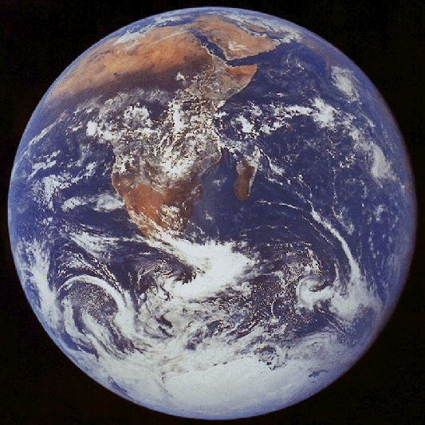
Environmental Track
The environmental track focuses on big picture concepts of the earth's systems and the chemistry, physics, and biology behind them
Core ChE curriculum provides a solid foundation for ESE courses.
Wide variety of courses to satisfy your environmental interests
Research is mainly in atmospheric chemistry and physics

Slide 10
Fall | Winter | Spring
ESE 101: Earth’s Atmosphere | ESE 103: Biogeochemical Cycles | ESE/Ch/Ge 175b: Environmental Organic Chemistry Hoffman
ESE 102: Earth’s Oceans |  | Ge/ESE/CE 226: Sediment Transport Mechanics and Morphodynamics
ESE 142: Aquatic Chemistry Adkins |  | Ge/ESE 149: Marine Geochemistry Adkins
Ge/ESE 143: Organic Geochemistry Sessions |  | ESE/Ge 152: Atmospheric Radiation Yung
ESE 150a: Seminar | ESE 150b: Seminar | ESE 150c: Seminar
ACM/ESE 118: Methods in Applied Statistics and Data Analysis Candes |  | ESE/Ge 153: Atmosphere and Ocean Dynamics Richardson
ESE/Ge 173: Topics in Atmosphere and Ocean Dynamics Schneider | Ge/ESE 154: Readings in Paleoclimate | ESE/Ge 173: Topics in Atmosphere and Ocean Dynamics
 | ChE/ESE 158: Aerosol Physics and Chemistry Flagan | Ge/ESE 155 Paleoceanography
ESE/Bi 166: Microbial Physiology Leadbetter | ESE/Bi 168: Microbial Metabolic Diversity Leadbetter | Ge/ESE 170: Microbial Ecology Orphan
ESE/Ge/Ch 172: Atmospheric Chemistry II Wennberg/Seinfeld |  | ESE/Ge/Ch 171: Atmospheric Chemistry Wennberg/Seinfeld
ESE 101: Current Problems in Environmental Science and Engineering Wennberg | ESE/Ch/Ge 175a: Environmental Organic Chemistry Hoffman

Slide 11
Sophomore Year
Ch 41a (Bi 122) | 9 | Ch 41b (L 103 b) | 9 | Ch 41c (Ay 1) | 9
ChE 62 (L 103a) | 9 | ChE 63a | 9 | ChE 63b | 9
ACM 95a | 12 | ACM 95b | 12 | ACM 95c | 12
Ma 2a | 9 | Ma 2b | 9 | Ch/ChE 9 (H108b) | 9
Ph 12a | 9 | Ph 12b | 9 | PE 24 | 3
ChE 80 | 6 |  |  | BEM/Ec 146 | 9
Totals | 54 |  | 51 |  | 51
Junior Year
ChE 103a | 9 | ChE 103b | 9 | ChE 103c | 9
Ch 21a | 9 | Ch 21b | 9 | ChE 105 | 9
ESE 101 | 9 | ChE 101 | 9 | ESE 171 | 9
ESE 102 | 9 | ESE 103 | 9 | ESE 158 | 9
PS 12 | 9 | En110 | 9 | HPS 167 | 9
 |  | Ch/ChE 91 | 3 | ChE 80 | 6
Totals | 45 |  | 48 |  | 51
Senior Year
ChE 90a | 9 | ChE 90b | 9 | ChE 120 | 9
ChE 126 | 9 | PS 139 | 9 | ESE XXX | 9
ESE 130 | 9 | Ec 11 | 9 | ESE 139 | 9
En XXX | 9
Totals | 36 |  | 27 |  | 27

Slide 12
Environmental Track Advice
Know your options, plan ahead
Wide range of ESE classes to take, very flexible
ESE 100 series as prerequisites
Can find particular sequences of ESE classes after that
ESE 158 and ESE 171 are good courses to take
When planning, keep track of alternating years
Keep first term senior year light
Do research!
Profs Flagan, Seinfeld are titans in the aerosol community
Skills gained from research valuable in other fields

Slide 13
Future Opportunities
Well equipped to tackle world’s most pressing problems
Climate change, clean water, clean air, clean energy, health
Graduate School (Chemical Engineering, Environmental Sci./Eng.)
Energy Companies
They have a stake in renewable energy and their impact
Government (Regulatory Agencies)
Large volume of positions, but not too many entry level
Once you're in, you're in
Environmental Consulting

Slide 14
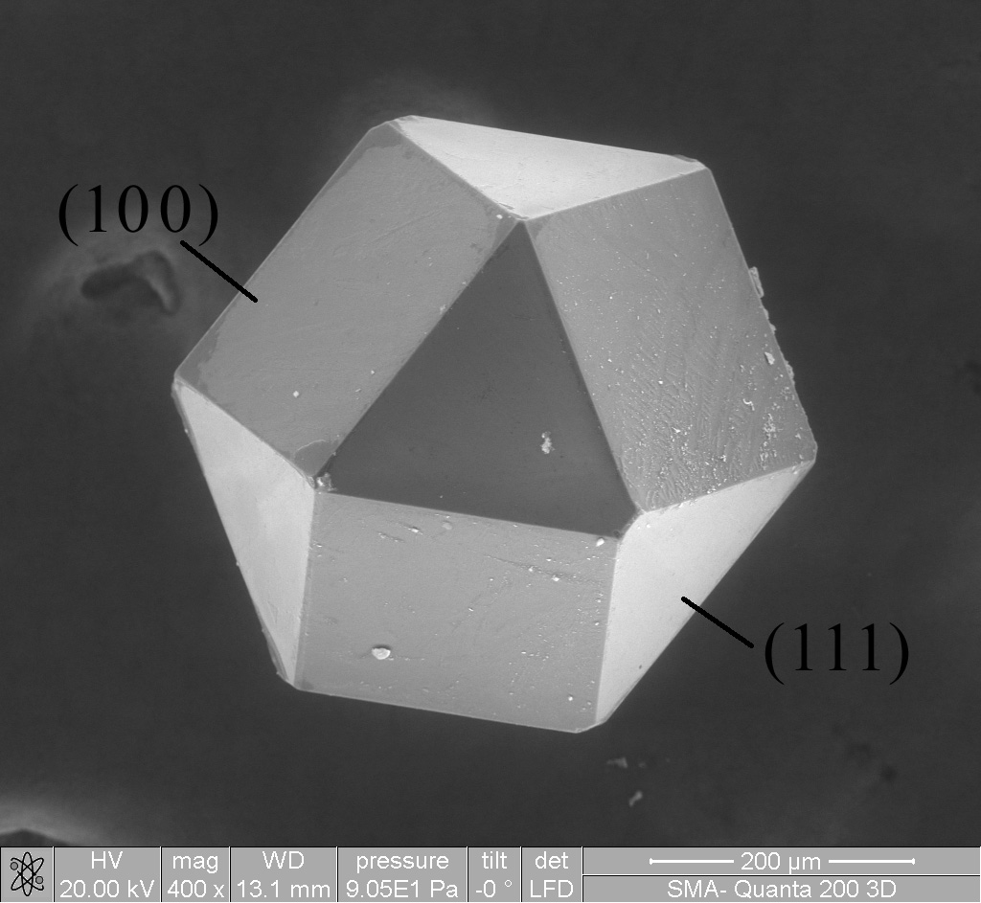
Materials Track
Why ChE MS?
Provides solid background in processing of materials
OPTIMIZATION!

Slide 15
Materials Track Courses
Either ChE 128 or ChE90ab
One of the following: Ch/ChE 147, ChE115, or MS133
One of the following: Ch120, ChE/Ch148, MS115, MS/APh120, MS/APh122, or MS131
Five materials science elective courses
Chosen from ChE118, ChE120, ChE/Ch155, ChE/Ch164, ChE/Ch165, or any MS courses

Slide 16
Sophomore Year
Ch 41a | 9 | Ch 41b | 9 | Ch 41c | 9
ChE 62 | 9 | ChE 63a | 9 | ChE 63b | 9
ACM 95a | 12 | ACM 95b | 12 | ACM 95c | 12
Ma 2a | 9 | Ma 2b | 9 | Ch/ChE 9 | 9
Ph 2a | 9 | Ph 2b | 9 | HSS | 9
Totals | 48 |  | 48 |  | 48
Junior Year
ChE 103a | 9 | ChE 103b | 9 | ChE 103c | 9
Ch 21a | 9 | ChE 101 | 9 | ChE 105 | 9
MS115 | 9 | Ch21b | 9 | ChE 115 | 9
CS 1 | 9 | MS/ME 162 | 9 | HSS | 9
HSS | 9 | HSS | 9 | HSS | 9
Totals | 45 |  | 45 |  | 45
Senior Year
ChE 126 | 9 | ChE 90a | 9 | ChE 90b | 9
MS/APh 120 | 9 | Ch/ChE 91 | 3 | MS/EST 143 | 9
MS/APh 122 | 9 | ChE/Ch 164 | 9 | HSS | 9
HSS | 9 | HSS | 9
 |  | HSS | 9
Totals | 36 |  | 39 |  | 27

Slide 17
Materials Track Advice
Plan ahead!
Keep your course options open
If it’s offered, TAKE IT
MS courses are not always offered, even if mentioned in catalog
Courses may say “offered every other year”, but that’s a lie 90% of the time

Slide 18
Future Opportunities
Materials track is very diverse!
Grad school
Chemical Engineering
Materials Science Engineering
Industry
Electronics, Semiconductors
Polymers, Plastics
Product and Material Design
Alternative Energy, Oil

Slide 19
Process Systems Track
“Unprecedented flexibility”
ChE 128 or ChE 90ab
ChE 118 & ChE 120
Process engineering & design course
5 ANY engineering electives
Basically you can build your own track
Ideas: Combine multiple tracks, advanced ChE track, computational track, “businessy” track

Slide 20
Process Systems Track Advice
Plan Ahead
Can study abroad more easily if you want
Take electives from other tracks or other fields of engineering
Ken Pickar minor (E 105, E 102, E 103) – business oriented
Team based projects
Solving practical problems
Some CS classes overlap with other engineering
Some advanced ChE classes don’t count for other tracks
Possible to double with BEM, minor in CS

Slide 21
Sophomore Year
Ch 41a | 9 |  | Ch 41b |  | 9 | Ch 41c | 9
ChE 62 | 9 |  | Ec 11 |  | 9 | ChE 63b | 9
ACM 95a | 12 |  | ACM 95b |  | 12 | ACM 95c | 12
Ma 2a | 9 |  | ChE 15 |  | 9 | Ch/ChE 9 | 9
Ph 2a | 9 |  | Ph 2b (extra) |  | 9 | PS 12 | 9
Soccer | 3 |  | Took 63 a frosh year |  | 0 | (Some take 105 here) | 0
Totals | 51 |  |  |  | 48 |  | 48
Junior Year
ChE 103a |  | 9 |  | ChE 103b | 9 | ChE 103c | 9
Ch 21a |  | 9 |  | Ch 21b | 9 | Ch 21c | 9
MS 115 |  | 9 |  | ChE 101 | 9 | ChE 105 | 9
Ec 122 |  | 9 |  | PS 141 a | 9 | ESE 171 | 9
Ec 130 |  | 9 |  | PS 128 | 9 | H 160 | 9
Totals |  | 45 |  |  | 45 |  | 45
Senior Year
ChE 126 |  | 9 |  | ChE 118 | 9 | ChE 120 | 9
ChE 165 |  | 9 |  | ChE 90 b | 9 | HSS | 9
ChE 107 |  | 9 |  | ChE 164 | 9 | Idk (ChE 148?) | 9
ChE 90 a |  | 9 |  | HSS | 9 | Idk | 9
Ch/ChE 91 |  | 3
PE |  | 3
Totals |  | 42 |  |  | 36 |  | 36
Now only 2 terms of ACM
No more additional science/engineering electives needed
Ph 2b, some senior year classes in my schedule to the right

Slide 22
Future Opportunities
Flexible
Grad School
Industry
Non-ChE: Finance, Consulting,
If you want to do Finance/Consulting, be ChE because you love ChE. There are easier majors if you want to go that route.

Slide 23
Other Opportunities
Studying abroad is possible
Cambridge, Edinburgh, Copenhagen
Not UCL: all ChE courses are year-long
Double majoring or minoring is also possible
Usually within HSS (BEM, English), CS minor
Don’t necessarily need to overload
These things just take some planning and foresight: think about it now, if you’re interested!

Slide 24
Sophomore Year
Ch 41a | 9 |  | Ch 41b |  | 9 | Ch 41c |  | 9
ChE 62 | 9 |  | ChE 63a |  | 9 | ChE 63b |  | 9
ACM95a | 12 |  | ACM95b |  | 12 | ACM95c |  | 12
Ma 2a / Ph 2a | 18 |  | Ma 2b / Ph 2b |  | 18 | Ch 9 |  | 9
 |  |  |  |  |  | En |  | 9
Totals | 48 |  |  |  | 48 |  |  | 48
Junior Year
ChE 103a |  | 9 |  | ChE 103b | 9 | ChE 103c | 9
Ch 21a |  | 9 |  | ChE 101 | 9 | ChE 105 | 9
MS115a |  | 9 |  | Ch21b | 9 | En | 9
En |  | 9 |  | MS Elective | 9 | SS | 9
En |  | 9 |  | En | 9 | Ch/ChE91 | 3
PE |  | 3 |  |  |  | PE | 3
Totals |  | 48 |  |  | 45 |  | 42
Senior Year
Cambridge |  | ChE 90a | 9 | ChE 90b | 9
MS Elective | 9 | ChE 128 | 9 | En | 9
MS Elective | 9 | Ch/ChE 147 | 9 | SS | 9
MS Elective | 9 | En 99b | 9 | SS | 9
MS Elective | 9 | En | 9 | PE | 3
En 99a | 9
Totals | 45 |  | 45 |  | 39
Senior Year
Edinburgh |  | ChE 90a | 9 | ChE 90b | 9
MS Elective | 9 | ChE 128 | 9 | MS Elective | 9
MS Elective | 9 | Ch/ChE 147 | 9 | En 99b | 9
MS Elective | 9 | En 99a | 9 | SS | 9
En | 9 | En | 9 | PE | 3
SS | 9
Totals | 45 |  | 45 |  | 39

Slide 25
Chemistry Track
“Unprecedented flexibility”
5 100+ level electives
Ch213a
5 laboratory classes
Ch 90, 91
Ma 3 “recommended”
Ch 14
Sucks

Slide 26
Concluding Remarks
The Tracks will not:
Affect your chances at graduate school
Affect your chances at a job too much
Affect what area you end up going into (in graduate school you can start from scratch, to a degree)
The Tracks will:
Allow you to take graduate level classes in an area of interest
Show recruiters that you can diversify into related fields

Slide 27
Questions?

